Slide 1
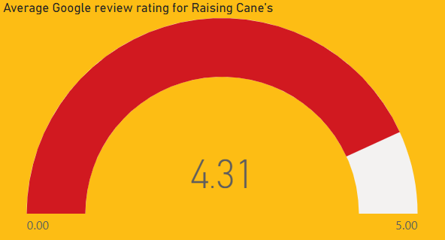
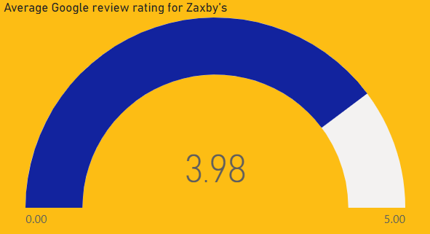
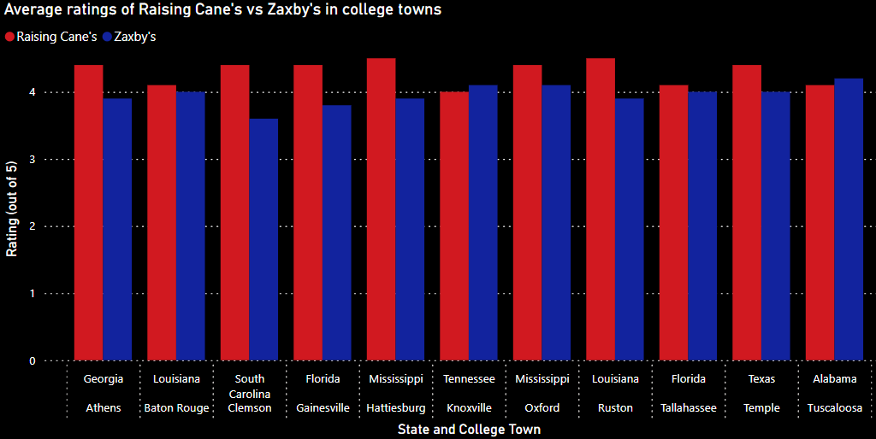

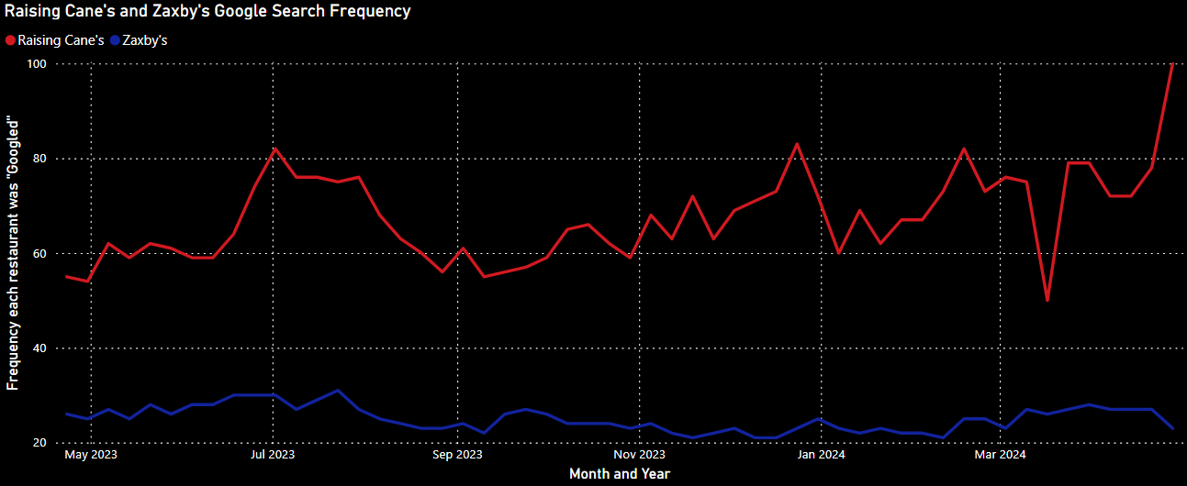
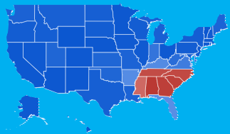
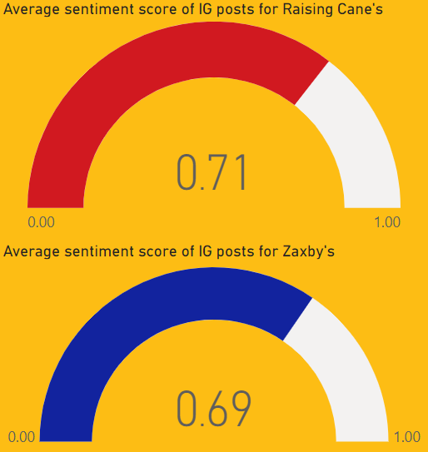

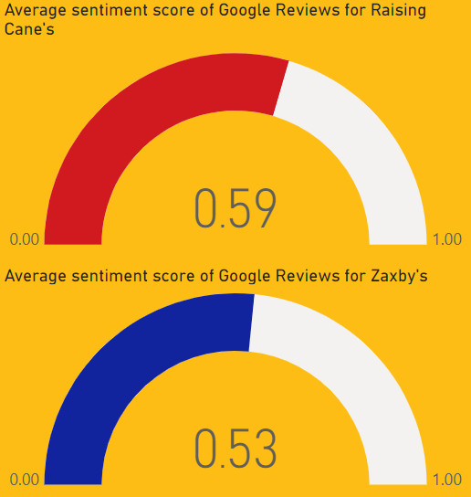

Raising Cane’s is better than AND is more popular than Zaxby’s!
Average Google reviews are higher for Raising Cane’s than they are for Zaxby’s! Below is the average rating for both in college towns (since we know college students have the best taste) that have both Cane’s and Zaxby’s.
Okay, it’s higher rated, but is it more popular?
Not only is Raising Cane’s searched more frequently on Google overall, but Zaxby’s is only the more popular search in 6 states (one of which is the state it was founded). Sentiment Analysis of IG posts and the actual content of Google reviews back these trends up!
Sentiment Analysis!

